Slide 1
Reminders
Homework 7 due Date is Due by Midnight on 3/25. HW8 will be due 4/1.
Sign-up Sheet for Project Option or Homework Option due tonight
Quiz on Chapters 12-14 will be released soon, Due on Monday

Slide 2
Review: Dependency Parsing
Jurafsky and Martin Chapter 15

Slide 3
Review: Dependency Formalism
The dependency structures are directed graphs.
G = (V, A)
where V is a set of vertices and A is a set of ordered pairs of vertices (or directed arcs). Each arc points from the head to a dependent
Directed arcs can also be labeled with the grammatical relation that holds between the head and a dependent.
Head
Dependent
Notes:
Familiar notions such as subject, direct object and indirect object are examples of grammatical relations. In English these notions strongly correlate with both position in a sentence and constituent type and are therefore somewhat
redundant with the kind of information found in phrase-structure trees. However, in
more flexible languages the information encoded directly in these grammatical rela-
Universal Dependencies
tions is critical since phrase-based constituent syntax provides little

Slide 4
Review: Dependency Trees
A dependency tree is a digraph where:
There is a single designated root node that has no incoming arcs
Each vertex has exactly one incoming arc (except the root node)
There is a unique path from the root node to each vertex in V
This mean that each word in the sentence has exactly one head.
Labeled dependency trees add labels to arcs to specify the grammatical relationship between the head and the dependent.
relation
Head
Dependent
Relations can be things like nsubj and dobj identify the subject and direct object

Slide 5
2 styles of drawing dep. trees
Head
Dependent
relation
Head
Dependent

Slide 6
Review: Transition-based Parsing
Transition-based parsing systems employ a greedy stack-based algorithm to create dependency structures.
Parsing consists of a sequence of “shift-reduce” transitions.
Once all the words have been moved off the stack, they have each and been assigned a head (and an appropriate relation).
The resulting configuration is a dependency tree.

Slide 7
Review: Operators
There are three transition operators that will operate on the top two elements of the stack:
LEFTARC: Assert a head-dependent relation between the word at the top of the stack and the word directly beneath it; remove the lower word from the stack.
RIGHTARC: Assert a head-dependent relation between the second word on the stack and the word at the top; remove the word at the top of the stack;
SHIFT: Remove the word from the front of the input buffer and push it onto the stack.

Slide 8
input buffer:
Book
me
a
morning
flight
stack:
Root
}
Parser
Action: Shift
Root
Book
me
a
morning
flight

Slide 9
input buffer:
me
a
morning
flight
Book
}
Parser
stack:
Root
Action: Shift
Root
Book
me
a
morning
flight

Slide 10
input buffer:
a
morning
flight
me
}
Parser
stack:
Book
Action: RightArc
Root
iobj
Root
Book
me
a
morning
flight

Slide 11
input buffer:
a
morning
flight
Book
}
Parser
stack:
Root
Action: Shift
iobj
Root
Book
me
a
morning
flight

Slide 12
input buffer:
morning
flight
a
}
Parser
stack:
Book
Action: Shift
Root
iobj
Root
Book
me
a
morning
flight

Slide 13
input buffer:
flight
morning
stack:
}
Parser
a
Action: Shift
Book
Root
iobj
Root
Book
me
a
morning
flight

Slide 14
input buffer:
flight
}
Parser
stack:
morning
Action: LeftArc
a
Book
Root
iobj
nmod
Root
Book
me
a
morning
flight

Slide 15
input buffer:
flight
}
Parser
stack:
a
Action: LeftArc
Book
Root
det
iobj
nmod
Root
Book
me
a
morning
flight

Slide 16
input buffer:
flight
}
Parser
stack:
Book
Action: RightArc
Root
dobj
det
iobj
nmod
Root
Book
me
a
morning
flight

Slide 17
input buffer:
stack:
Book
}
Parser
Root
Action: RightArc
dobj
det
root
iobj
nmod
Root
Book
me
a
morning
flight

Slide 18
input buffer:
Root
}
Parser
stack:
Action: Done
dobj
det
root
iobj
nmod
Root
Book
me
a
morning
flight

Slide 19
Running time
The transition-based parser takes a single pass through the input sentence. It places each word on the stack exactly ones, and pops each word exactly once.
The running time is therefore O(N), for sentence length of N.
The algorithm is greedy and makes its best prediction for which operation should be take at each time step.
How does it decide between the 3 options? The Oracle

Slide 20
Creating the Oracle
SOTA transition-based systems use supervised machine learning methods to train classifiers that play the role of the oracle, which takes in as input a configuration and returns as output a transition operator.
Problem: What about the training data? To train the oracle, we need configurations paired with transition operators, which aren’t provided by the Treebanks…
Solution: simulate the operation of the parser by running the algorithm and relying on a new training oracle to give correct transition operators for each successive operation.

Slide 21
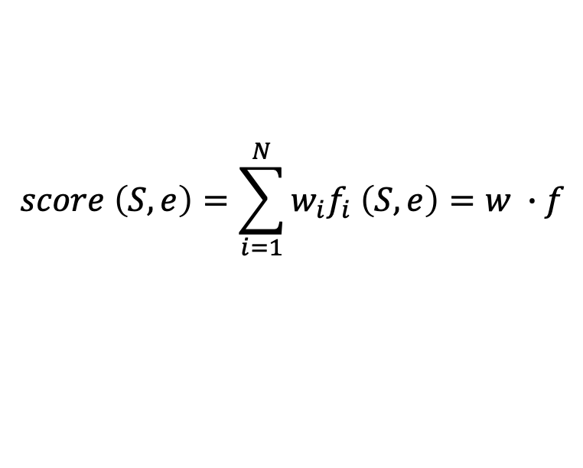
Training
While we can compute the score of tree as a sum of the scores of the edges that comprise it, each edge score can also be reduced to a weighted sum of features extracted from it.
Commonly used features include:
$$score \left(S, e\right)=\sum_{i=1}^{N}{w_{i}f_{i} \left(S, e\right)}=w ∙f$$
Wordforms, lemmas and POS of the headword and dependent
Corresponding features of contexts before, after and between words
Word embeddings
Dependency relation type
Direction of the relation (to the right or to the left)
Distance from the head to the dependent

Slide 22
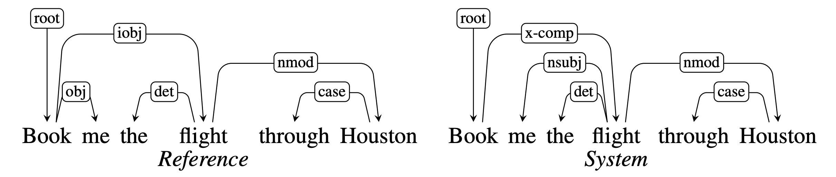
Evaluation
The common method for evaluating dependency parsers are labeled attachment accuracy (LAS) and unlabeled attachment accuracy
Labeled attachment refers to the proper assignment of a word to its head with the correct dependency relation.
Unlabeled attachment refers to the proper assignment of a word to its head ONLY (ignores dependency relation)
LAS = 4/6, UAS = 5/6

Slide 23
HW8: Learning Hypernyms
http://computational-linguistics-class.org/homework/hypernyms/hypernyms.html

Slide 24
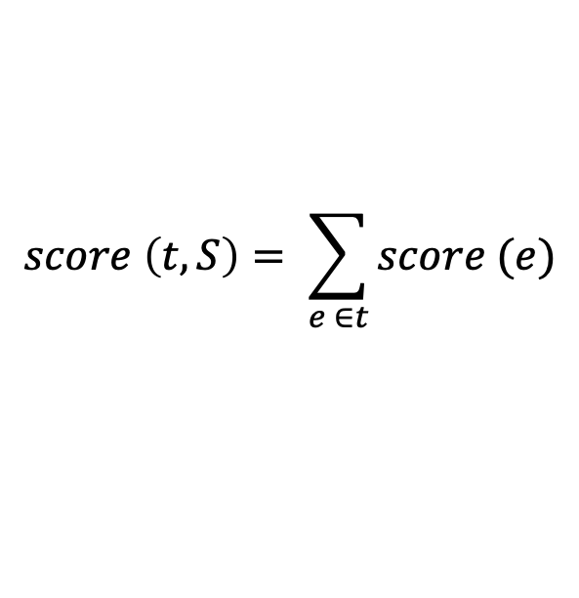
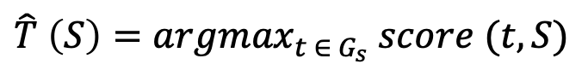
Graph-based Parsing
Graph-based methods for creating dependency structures search through the space of possible dependency trees for a tree that maximizes some score function:
where, the score for a tree is based on the scores of the edges that comprise the tree:
A common approach involves the use of maximum spanning trees (MST)
$$\hat{T} \left(S\right)={argmax}_{t ∈{ G}_{s}} score (t, S)$$
$$score \left(t, S\right)= \sum_{e ∈t}{score (e)}$$

Slide 25
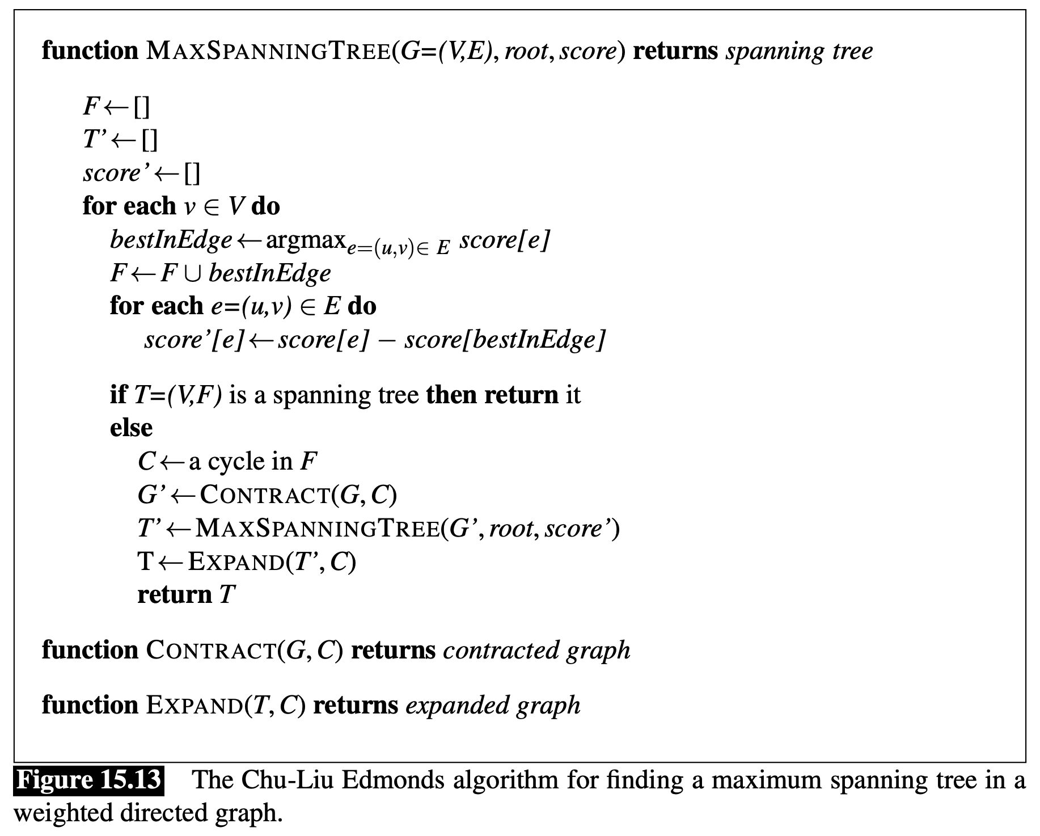

Slide 26
Logical Representation of Sentence Meaning
Jurafsky and Martin Chapter 16

Slide 27
Computational Semantics
So far, we have discussed one kind of meaning representation in the form of word vectors or word embeddings.
What kind of reasoning does that representation allow us to draw?
Words are similar to each other
Analogical reasoning

Slide 28
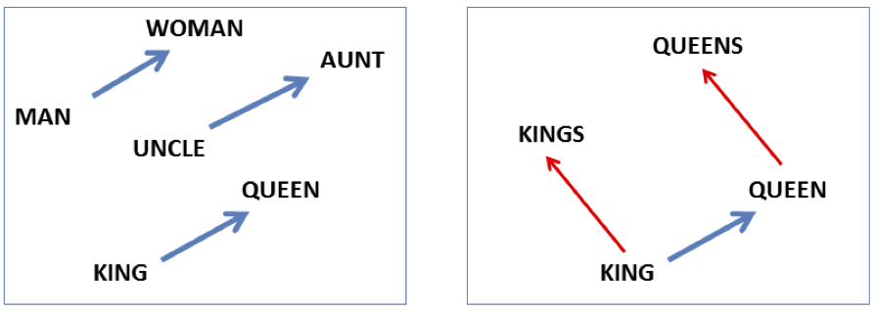
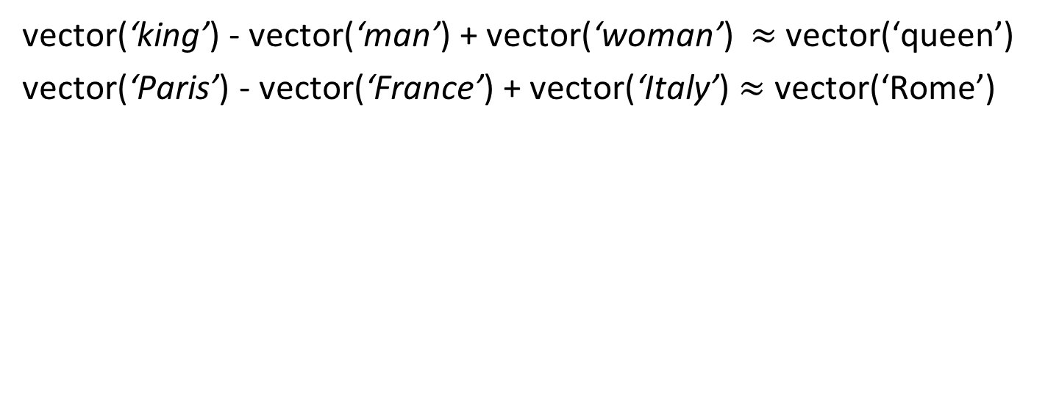
Analogy: Embeddings capture relational meaning
vector(‘king’) - vector(‘man’) + vector(‘woman’) $≈$vector(‘queen’)
vector(‘Paris’) - vector(‘France’) + vector(‘Italy’) $≈$ vector(‘Rome’)
Notes:
Analogy Another semantic property of embeddings is their ability to capture relational meanings. Mikolov et al. (2013b) and Levy and Goldberg (2014b) show that the offsets between vector embeddings can capture some analogical relations between words. For example, the result of the expression vector(‘king’) - vec- tor(‘man’) + vector(‘woman’) is a vector close to vector(‘queen’); the left panel in Fig. 6.14 visualizes this, again projected down into 2 dimensions. Similarly, they found that the expression vector(‘Paris’) - vector(‘France’) + vector(‘Italy’) results in a vector that is very close to vector(‘Rome’).

Slide 29
Computational Semantics
An important kind of reasoning that word embeddings don’t support is logical inference like this:
All animals have an ulnar artery.
Dogs are a kind of animal.
⇒
All dogs have an ulnar artery
Today we will discuss meaning representations that allow us to link linguistics structures (words and sentences) onto a representation of the state of the world, and perform inferences.

Slide 30
Semantic Parsing
The process whereby meaning representations are created and assigned to linguistic inputs is called semantic parsing or semantic analysis.
Linguistic Expression: I have a car
Meaning representation:

Slide 31
Meaning Representation
A meaning representation consists of structures composed from a set of symbols, or representational vocabulary, which correspond to
Objects (speaker, car)
Properties of objects (red(car))
Relation among objects (owns(speaker, car) )
These describe some state of the world, which we are trying to represent and reason about.

Slide 32
Meaning Representation
Meaning representations can be viewed both as
Representations of the meaning of a linguistic input, and
As representations of the state of affairs in the world.
This is going to allow us to link linguistic inputs to the world and use our knowledge of the world to reason about whether statements are true, or to answer questions by returning objects that matching variables in the question.

Slide 33
Desirable Properties for Meaning Representations
Verifiability
Unambiguous Representations
Canonical Forms
Make inferences
Match variables

Slide 34
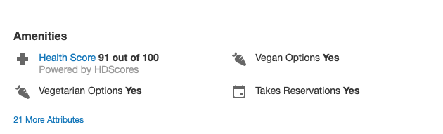
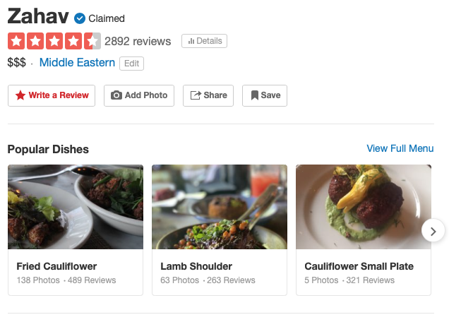
Verifiability
One application that we would like to use meaning representations for is to support question answering systems against a knowledge base.
Does Zahav serve vegetarian food?
We want a representation like serves(Zahav, vegetarian) representation that could be queried against Yelp’s KB.

Slide 35

Unambiguous representation
I want to eat someplace that’s near Penn’s campus.

Slide 36
Unambiguous representation
I want to eat someplace that’s near Penn’s campus.
Our meaning representations itself cannot be ambiguous, so that the the system can reason over a representation that means either one thing or the other in order to decide how to answer.
Note: Vagueness is OK!
Vagueness leaves some parts of the meaning underspecified but doesn’t give rise to multiple representations,

Slide 37
Canonical form
Distinct inputs that mean the same thing should have the same meaning representation.
Does Zahav have vegetarian dishes?
Do they have vegetarian food at Zahav?
Are vegetarian dishes served at Zahav?
Does Zahav serve vegetarian fare?
This is related to the task of paraphrase identification. Variations can be syntactic as well as lexical.
Notes:
Canonical form does complicate the task of semantic parsing. Our system must conclude that vegetarian fare, vegetarian dishes, and vegetarian food refer to the same thing, that having and serving are equivalent here, and that all these parse structures still lead to the same meaning representation.

Slide 38
Inference
A system needs to draw conclusions based on the meaning representation of inputs and its background knowledge in order to perform inference.
Does Zahav have vegetarian dishes?
Can vegetarians eat at Zahav?
These are different questions, and we need to use our commonsense reasoning to be able to answer them.
A system will need to use serves(Zahav, vegetarian) and other background knowledge to make the inference.

Slide 39
Variables
Finally, meaning representations must support varaible that are not connected to a particular object.
I would like to find a restaurant where I can get vegetarian food.
Which restaurants serve vegetarian food?
We will need to have a meaning representation like serves(x, vegetarian)
Where x can be replaced by some object in the KB that matches the whole proposition.

Slide 40
Model-Theoretic Semantics
A model allows us to bridge the gap between a formal representation and the world. The model stands in for a particular state of affairs in the world.
The domain of a model is the set of objects that are being represented. Each distinct thing (person, restaurant, cuisine) corresponds to a unique element in the domain
Properties of objects (like whether a restaurant is expensive) in a model correspond to sets of objects.
Relations between object (like whether a restaurant serves a cuisine) are are sets of tuples.

Slide 41
Notes:
The names for our domain elements are deliberately using meaningless, non-mnemonic to emphasize the fact that whatever it is that we know about these entities has to come from the formal properties of the model and not from the names of the symbols.

Slide 42
Katie likes Rio
Katie → c
Rio → g
likes → Likes
<c,g> ∈ Likes so Katie likes Rio
is True
Notes:
Each element of the vocabulary must have a denotation in the model, meaning that every element corresponds to a fixed, well-defined part of the model.
The function that maps from the vocabulary to the proper denotations in the model is an interpretation.

Slide 43
Denotation and Interpretation
A meaning representation has open-ended vocabulary of names for the objects, properties, and relations that make up the world we’re trying to represent.
Each element of the vocabulary must have a denotation in the model, meaning that every element corresponds to a fixed, well-defined part of the model.
The function that maps from the vocabulary to the proper denotations in the model is an interpretation.
Notes:
Each element of the vocabulary must have a denotation in the model, meaning that every element corresponds to a fixed, well-defined part of the model.
The function that maps from the vocabulary to the proper denotations in the model is an interpretation.

Slide 44
More complex sentences
Katie likes the Rio and Matthew likes the Med.
Katie and Caroline like the same restaurants.
Franco likes noisy, expensive restaurants.
Not everybody likes Frasca.
In order to verify whether the meaning representations corresponding to these sentences are true in our model, we need an additional set of logical operators like and, or, not, and quantifiers, and corresponding truth tables.
Assessing the truth conditions of complex examples still just involves simple set operations.

Slide 45
First-Order Logic
FOL is a meaning representation language that satisfies the desirable qualities that we outlined. It provides a computational basis for verifiability and inference.
It doesn’t have many requirements other than the represented world consists of objects, properties of objects, and relations among objects.

Slide 46
Basics of FOL
A term in FOL can consist of a constant, a function or a variable.
Constants are the objects in the world model
Functions are mapping to unique objects and can be expressed like LocationOf(Zahav)
Variables let us make assertions and draw inferences about objects without referring to a named object.

Slide 47
Relations
Predicates are symbols that name the relations that hold among a fixed number of objects.
A FOL representation for Zahav serves vegetarian food might look like the following formula:
Serves(Zahav, Vegetarian)
Predicates can have different number of arguments so the formula for Zahav is a restaurant
Restaurant(Zahav)

Slide 48
Logical Connectives
We can conjoin formula with logical connectives like and (∧), or (∨), not (¬), and implies (⇒)
Each one has a truth table:

Slide 49
Quantifiers and Variables
There are two quantifiers in FOL:
∃ – There exists
∀ – For all
For an indefinite noun phrase like
a restaurant that serves Mexican food near Penn
We use the existential quantifier and a variable.
∃x Restaurant(x) ∧ Serves(x,MexicanFood) ∧ Near((LocationOf(x),LocationOf(Penn))

Slide 50
Quantifiers and Variables
All restaurants in Philly are closed.
∀xRestaurant(x) ∧ Is((LocationOf(x), Philadelphia) ⇒ Closed(x,)

Slide 51
Reminders
Homework 8 due Date is Due by Midnight on 4/1.
If doing HW option, be sure to do IRB training ASAP
Quiz on Chapters 12-14 is due tonight at 11:59pm

Slide 52
Wrap Up: Logical Representation of Sentence Meaning
Jurafsky and Martin Chapter 16

Slide 53
Review: Desirable Properties for Meaning Representations
Verifiability – compare some meaning representation (MR) to a representation in a knowledge base (KB).
Unambiguous Representations – each ambiguous natural language meaning corresponds to a separate MR
Canonical Forms – paraphrases are collapsed to one MR
Make Inferences – draw valid conclusions based on the MR of inputs and its background knowledge in KB
Match variables – variables can be replaced by some object in the KB so an entire proposition will then match

Slide 54
Model-Theoretic Semantics
A model allows us to bridge the gap between a formal representation and the world. The model stands in for a particular state of affairs in the world.
The domain of a model is the set of objects that are being represented. Each distinct thing (person, restaurant, cuisine) corresponds to a unique element in the domain
Properties of objects (like whether a restaurant is expensive) in a model correspond to sets of objects.
Relations between object (like whether a restaurant serves a cuisine) are are sets of tuples.

Slide 55
Notes:
The names for our domain elements are deliberately using meaningless, non-mnemonic to emphasize the fact that whatever it is that we know about these entities has to come from the formal properties of the model and not from the names of the symbols.

Slide 56
Katie likes Rio
Katie → c
Rio → g
likes → Likes
<c,g> ∈ Likes so Katie likes Rio
is True
Notes:
Each element of the vocabulary must have a denotation in the model, meaning that every element corresponds to a fixed, well-defined part of the model.
The function that maps from the vocabulary to the proper denotations in the model is an interpretation.

Slide 57
Review: First-Order Logic
FOL is a meaning representation language that satisfies the desirable qualities that we outlined. It provides a computational basis for verifiability and inference.
Truth conditions for logical formula involving terms and predicates like Near(Goldie, Upenn)
Truth conditions for multiple formula with logical connectives
Truth conditions for quantifiers

Slide 58
Review: Logical Connectives
We can conjoin formula with logical connectives like and (∧), or (∨), not (¬), and implies (⇒)
Each one has a truth table:

Slide 59
Review: Quantifiers and Variables
There are two quantifiers in FOL:
Existential quantifier – ∃ – “There exists” – Is true if it holds at least one thing that matches the variable
Universal quantifier – ∀ – “For all” – Is true if it holds true for all of the things that match the variable

Slide 60
Review: Existential Quantifier
There is a restaurant that serves Mexican food near Penn
We use the existential quantifier and a variable to represent the indefinite noun phrase “a restaurant”.
∃x Restaurant(x) ∧ Serves(x,MexicanFood) ∧ Near((LocationOf(x),LocationOf(Penn))
For this to be true there must be at least one object such that if we were to substitute it for the variable x, the resulting formula would be true.
Notes:
For an indefinite noun phrase like

Slide 61
Review: Universal Quantifier
All restaurants in Philly are closed.
∀xRestaurant(x) ∧ Is((LocationOf(x), Philadelphia) ⇒ Closed(x)
The ∀ operator states that for the logical formula to be true, the substitution of any object in the knowledge base for the universally quantified variable should result in a true formula.

Slide 62
Lambda Notation
Lambda notation provides a way to abstract from fully specified FOL formulas by matching variables.
λx.P(x)
Such expressions consist of the symbol λ , followed by one or more variables, followed by a FOL formula that makes use of those variables
This process of λ-reduction consists of a simple textual replacement of the λ variables and the removal of the λ.
λx.P(x)(A)
P(A)

Slide 63
Lambda Example
One λ-expression can be used within another:
λx.λy.Near(x,y)
Apply lambda λ-reduction to x:
λx.λy.Near(x,y)(Bacaro)
λy.Near(Bacaro,y)
Apply lambda λ-reduction to y:
λy.Near(Bacaro,y)(Centro)
Near(Bacaro,Centro)
λ -notation provides a way to incrementally gather arguments to a predicate

Slide 64
Inference
A meaning representation language must support inference to add valid new propositions to a knowledge base or to determine the truth of propositions not explicitly in the KB.
Modus ponens provides if-then reasoning:
α α ⇒ β
β
α is the antecedent
β is the consequent
Notes:
the rule of logic stating that if a conditional statement (“if p then q ”) is accepted, and the antecedent ( p) holds, then the consequent ( q ) may be inferred.
All animals have an ulnar artery.
Dogs are a kind of animal.
⇒
All dogs have an ulnar artery

Slide 65
Inference
VegetarianRestaurant(Leaf ) ∀xVegetarianRestaurant(x) ⇒ Serves(x,VegetarianFood)
Serves(Leaf ,VegetarianFood)
Here, the formula VegetarianRestaurant(Leaf ) matches the antecedent of the rule, thus allowing us to use modus ponens to conclude Serves(Leaf ,VegetarianFood).

Slide 66
Forward Chaining
Forward chaining systems use modus ponens whenever new individual facts are added to the KB.
All applicable implication rules are found and applied, each resulting in the addition of new facts to the knowledge base.
These new propositions can also be used to fire implication rules applicable to them. The process continues until no further facts can be deduced.

Slide 67
Backward Chaining
In backward chaining, modus ponens is run in reverse to prove specific propositions called queries.
See if the query formula is true by determining if it is present in the knowledge base.
If not, search for applicable implication rules present in the knowledge base.
Applicable rules are ones where the consequent matches the query formula. If there are any such rules, then the query can be proved if the antecedent of any one them can be shown to be true. This can be performed recursively.

Slide 68
Backward Chaining ≠ Reasoning Backwards
Backward chaining reasons from queries to known facts.
Reasoning backwards goes from known consequents to unknown antecedents.
Reasoning backwards is an invalid. Sometimes it is useful for determining what is plausible. Plausible reasoning from consequents to antecedents is known as abduction.

Slide 69
Soundness and Completeness
Forward and backward chaining are both sound (meaning all inferences that we draw using them are valid). However, neither is complete.
The fact that they are not complete means that there are valid inferences that cannot be found by systems using these methods alone.
An alternative inference technique called resolution is but sound and complete, but it is far more computationally expensive, so most systems just use chaining.

Slide 70
Representing Events
One limitation of FOL is that it only allows events with a fixed arity (number of arguments).
Ideally, there would be a direct mapping from a verb’s subcategorization frame onto a FOL predicate.
Leaf serves vegetarian fare = Serves(Leaf ,VegetarianFare)
However, events are more complicated since events may involve a host of participants, props, times and locations.

Slide 71
Representing Events
Choosing the correct number of arguments for the predicate representing the meaning of eat is tricky.
I ate.
I ate a turkey sandwich.
I ate a turkey sandwich at my desk.
I ate at my desk.
I ate lunch.
I ate a turkey sandwich for lunch.
I ate a turkey sandwich for lunch at my desk

Slide 72
Event variables
Event variables to allow us to make assertions about an event without using a single predicate with a fixed number of arguments.
Event predicates are refactored with an existentially quantified variable as their only argument.
∃e Eating(e)
We can introduce additional predicates to represent the other information we have about the event. These predicates take an event variable as their first argument and related FOL terms as their second argument
∃e Eating(e) ∧ Eater(e, Speaker) ∧ Eaten(e, TurkeySandwich)
Notes:
Event representations lilke this referred to as neo-Davidsonian event representations for the philosopher Donald Davidson who introduced the notion of an event variable in the 1960s.

Slide 73
Neo-Davidsonian Events
Events are captured with predicates that take a single event variable as an argument.
We don’t need to specify a fixed number of arguments for a FOL predicate. Instead, we can glue on as many as are provided in the input.
No more roles are postulated than are mentioned in the input.
The connections across related inputs that share the same predicate are satisfied without the need for additional inference.
Notes:
Event representations lilke this referred to as neo-Davidsonian event representations for the philosopher Donald Davidson who introduced the notion of an event variable in the 1960s.
This approach still leaves us with the problem of determining the set of predicates needed to represent roles associated with specific events like Eater and Eaten, as well as more general concepts like Location and Time. We will return to this laterthis semester when we talk about Semantic Role Labeling.

Slide 74
Representing Time
Temporal logic gives us ways of representing when events occur.
Notes:
Time is not a flat circle (True Detective)

Slide 75
Representing Time
Temporal logic gives us ways of representing when events occur.
Time flows forward and that events are associated with either points or intervals in time, as on a timeline.
We can order distinct events by situating them on the timeline; one event precedes another if the flow of time leads from the first event to the second.
Represent the current moment in time as a point, and we can then easily define familiar notions of past, present, and future.
Notes:
Time is not a flat circle

Slide 76
Tense
These sentences only differ in the tense of the verb.
I arrived in New York.
I am arriving in New York.
I will arrive in New York.
A Neo-Davidsonian event representation would give us:
∃e Arriving(e) ∧ Arriver(e, Speaker) ∧ Destination(e, NewYork)
How can we represent the temporal information specified by the verb tense? By predicating additional information about the event variable e.

Slide 77
Tense
Past tense – I arrived in NY.
∃e Arriving(e) ∧ Arriver(e, Speaker) ∧ Destination(e, NewYork) ∧ IntervalOf(e, i) ∧ EndPoint(i, n) ∧ Precedes(n,Now)
Present tense – I am arriving in NY.
∃e Arriving(e) ∧ Arriver(e, Speaker) ∧ Destination(e, NewYork) ∧ IntervalOf(e, i) ∧ MemberOf(i,Now)
Future tense – I will arrive in NY.
∃e Arriving(e) ∧ Arriver(e, Speaker) ∧ Destination(e, NewYork) ∧ IntervalOf(e, i) ∧ EndPoint(i, n) ∧ Precedes(Now, n)

Slide 78
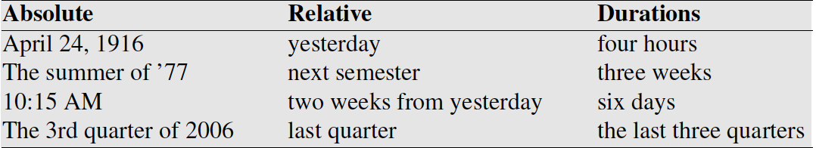
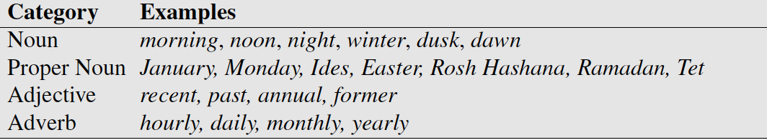
Temporal Expressions
Lexical triggers for temporal expressions:
Temporal normalization
mapping a temporal expression to either normalization a specific point in time or to a duration

Slide 79
Other Temporal Phenomena
Order – a pair of events can precede or follow each other, they or overlap and may have different onset times.
Duration – we might want to model how long an event typically takes
I went to college to get a degree
I went to the salon to get a haircut
Frequency / periodicity
Presidential elections take place ever 4 years
Stationarity – permanent versus impermanent events
The Statue of Liberty is in New York
The Coronavirus is in New York

Slide 80
Conclusion
Formal meaning representations that capture the meaning-related content of linguistic inputs. These representations are intended to bridge the gap from language to common-sense knowledge of the world.
Meaning representation languages like FOL specify syntax and semantics of these representations. Many others have been used in NLP and AI.
Important elements of semantic representation including states and events can be captured in FOL.
Description Logics consist of useful and computationally tractable subsets of full First-Order Logic

